Slide 1
Capstone Project
The Battle of Neighborhoods
Vilnius
Author: Sarunas Ramanauskas

Slide 2
Introduction
Vilnius is a capitol of Lithuania. Is a very fast growing city. A new invester would like to open a new restaurant The objective of this project is to use Foursquare location data and regional clustering of venue information to determine what might be the ‘best’ neighborhood in Vilnius to open a restaurant. Through this project, we will find the most suitable location for an entrepreneur to open a new restaurant in Vilnius, Lithuania.

Slide 3
Introduction
Target Audience
This project is aimed towards Entrepreneurs or Business owners who want to open a new Restaurant or grow their current business. The analysis will provide vital information that can be used by the target audience.
Data Overview
The data that will be required will be a combination of CSV files that have been prepared for the purposes of the analysis from multiple sources which will provide the list of neighborhoods in Vilnius (https://en.wikipedia.org/wiki/Neighborhoods_of_Vilnius), the Geographical location of the neighborhoods (via Geocoder package) and Venue data pertaining to restaurants (via Foursquare). The Venue data will help find which neighborhood is best suitable to open an restaurant.

Slide 4
Business Problem
Important questions:
1.Which Neighborhood is good for newcomer in Vilnius?
2.Which type of Restaurants is popular in this city and which not?

Slide 5
Methodology
Business Understanding
The aim of this project is to find the best neighborhood of Vilnius to open a new restaurant.
Analytical Approach
The total number of neighborhoods in Vilnius are 21 so we need to find a way to cluster them based on their similarities, that are the number and the kind of restaurant.
Briefly, after some steps of Data Cleaning and Data Exploration, I will use a K-Means algorithm to extract the clusters, produce a map and make an argument on the final result.
Data Exploration
To explore the data, I will use “Folium” a python library that can create interactive leaflet map using coordinate data.

Slide 6
Data
1. Vilnius Neighborhoods via Wikipedia
https://en.wikipedia.org/wiki/Neighborhoods_of_Vilnius
2. Geographical Location taken from same page as above
3. Venue Data using Foursquare

Slide 7
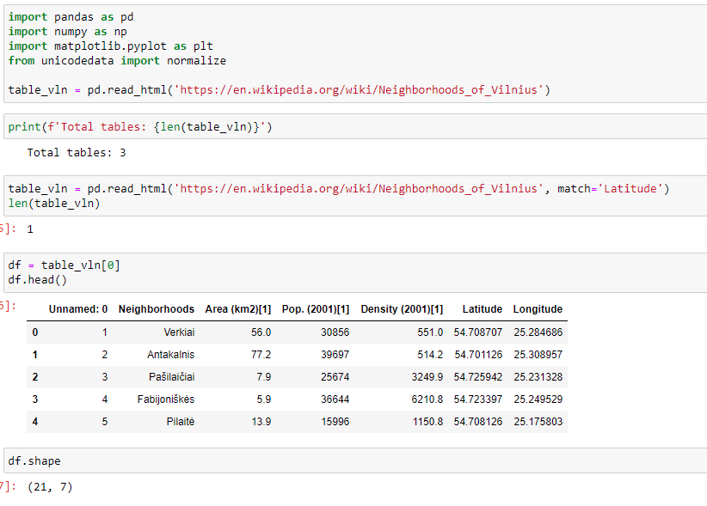
Transfer data from Wikipedia to data frame

Slide 8
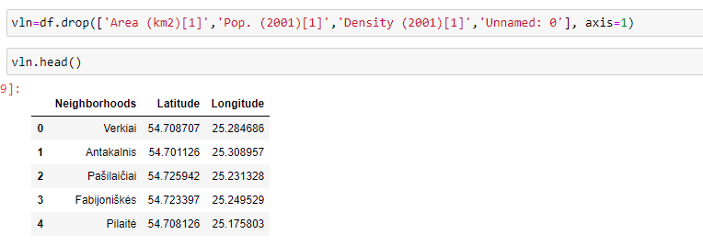
Data cleansing

Slide 9
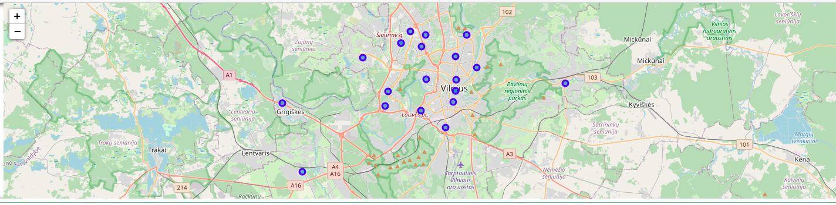
Map of Vilnius with marked neighborhoods

Slide 10
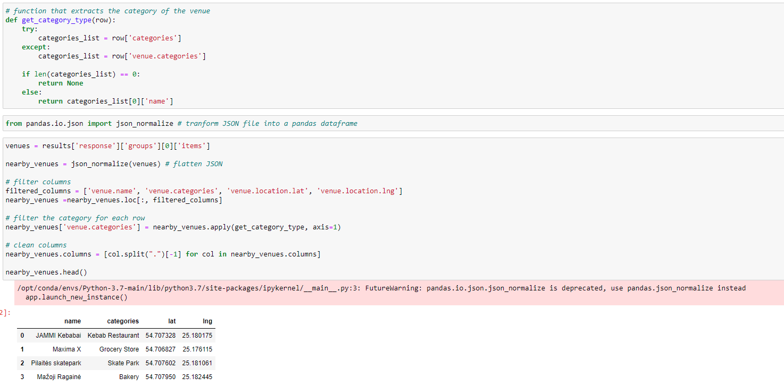
Using Foursquare API we get a Venues of each neighborhood

Slide 11
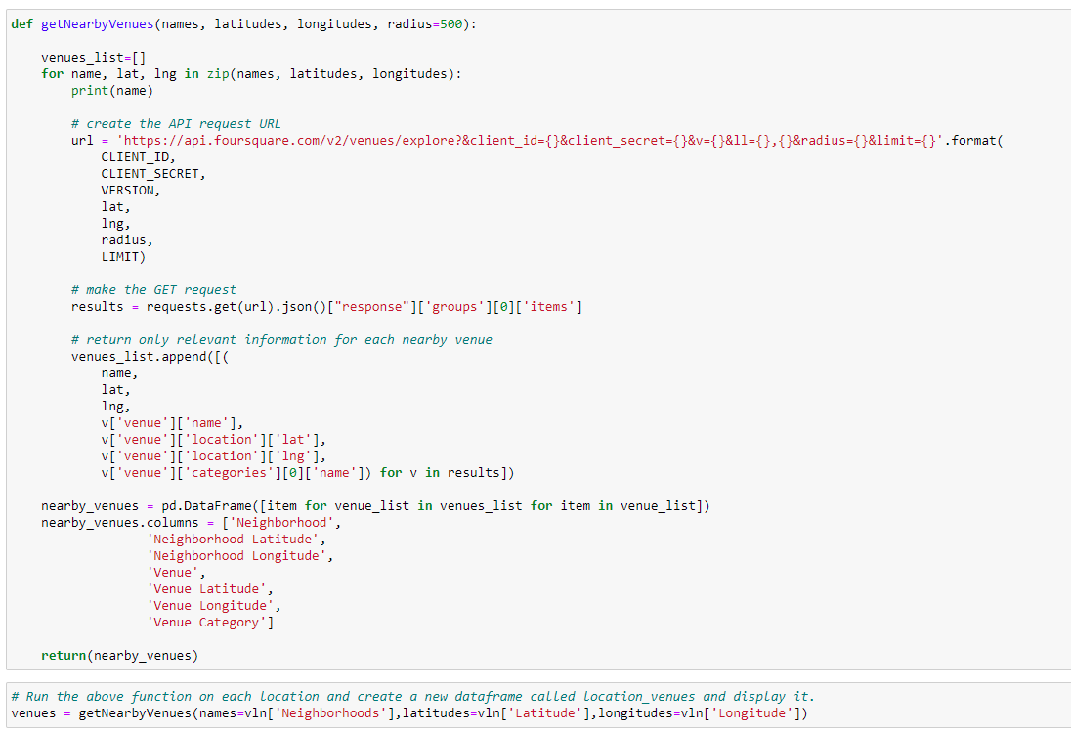
Using Foursquare API we get a Venues of each neighborhood

Slide 12
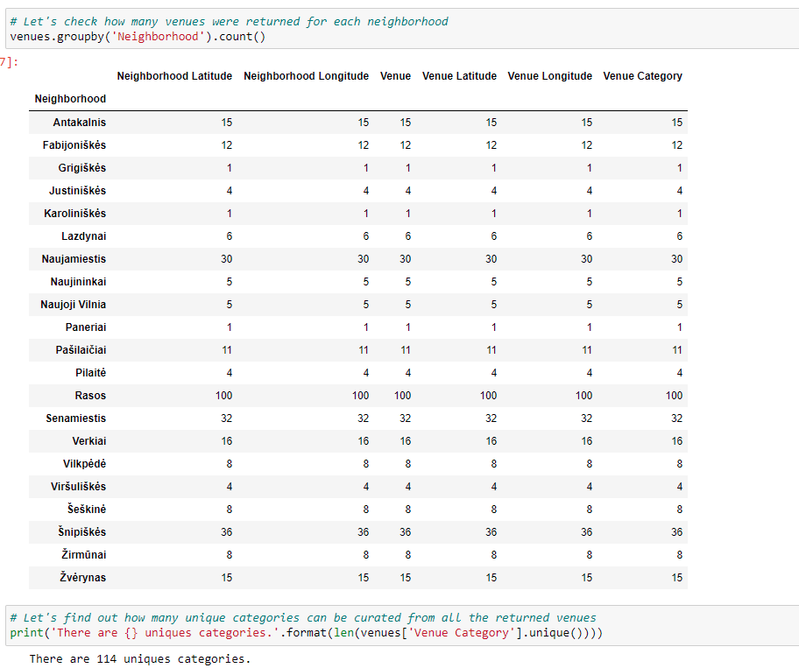
How many venues were returned for each neighborhood

Slide 13
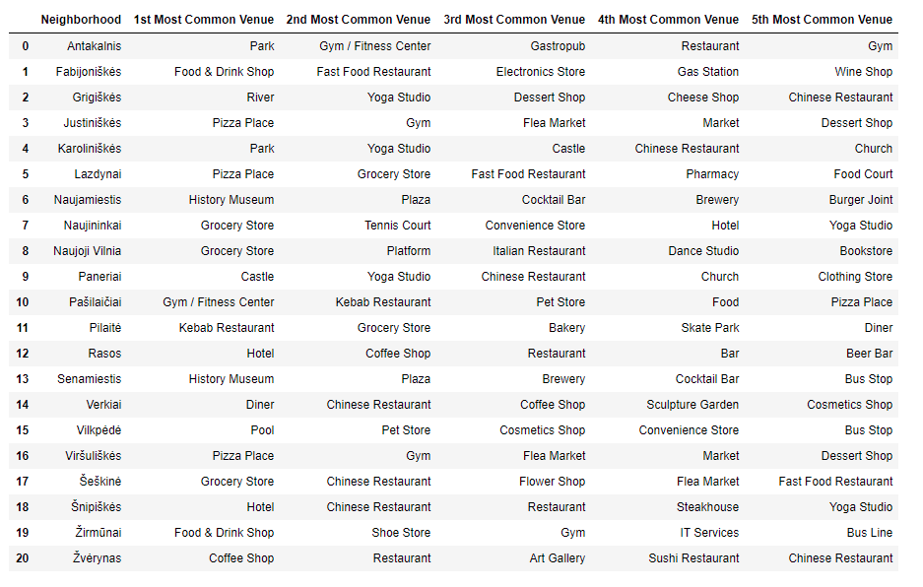
Neighborhood with the top 5 most common venues

Slide 14
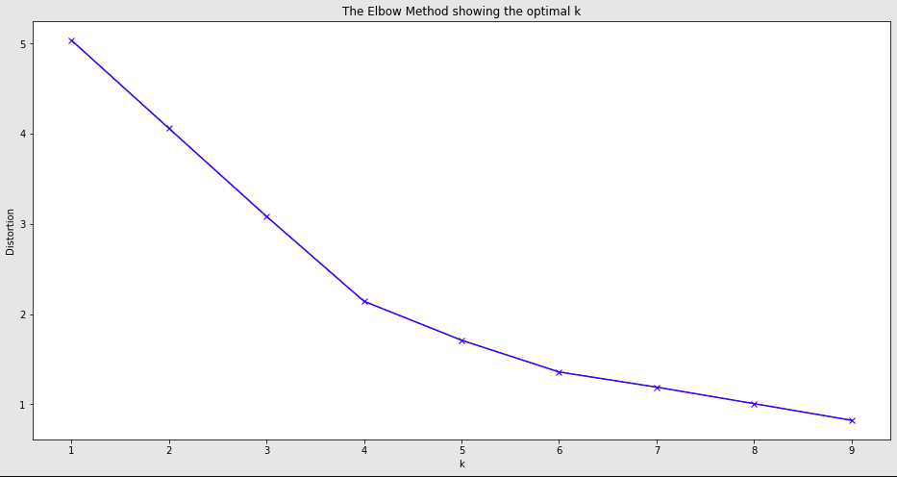
Making a clusters. The Elbow Method showing the optimal k

Slide 15
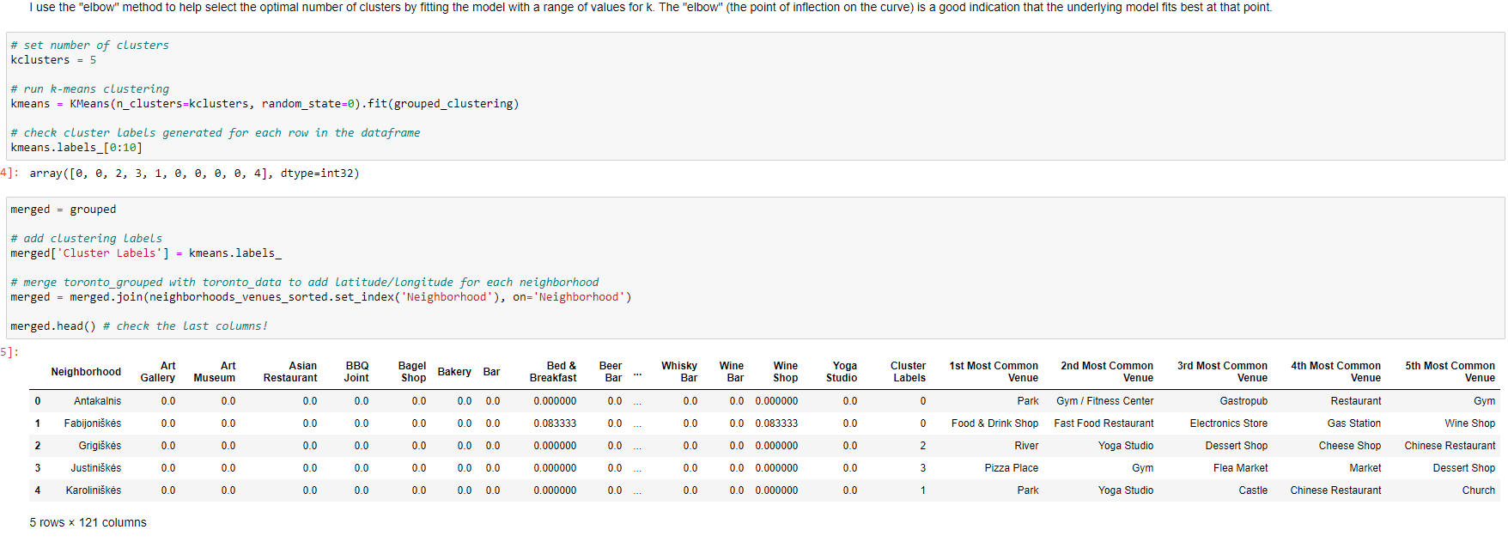
Making a clusters

Slide 16
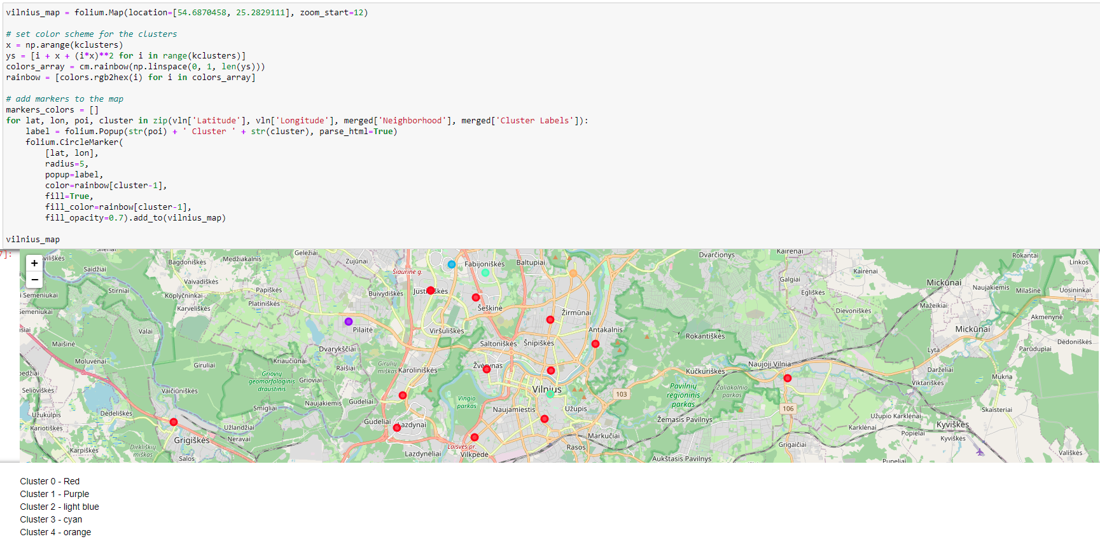
Making a clusters. Vilnius map with 5 clusters.

Slide 17
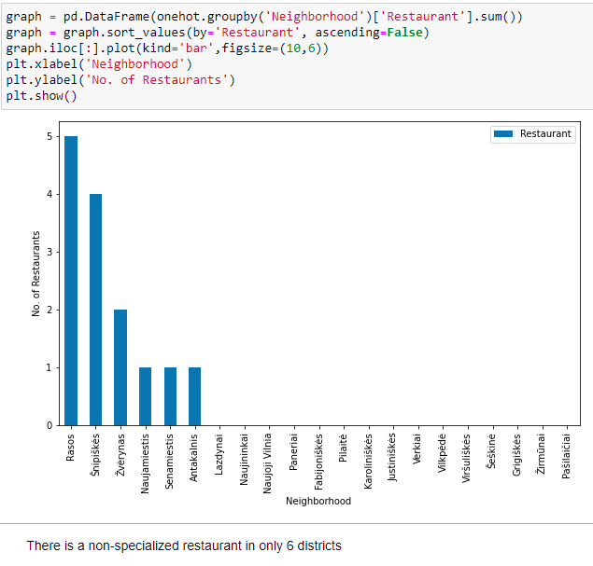
Non-specialized restaurant in Vilnius

Slide 18
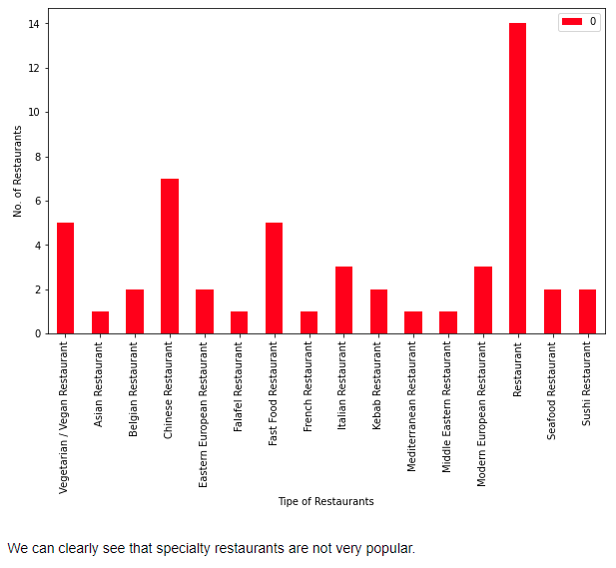
Specialty restaurants

Slide 19
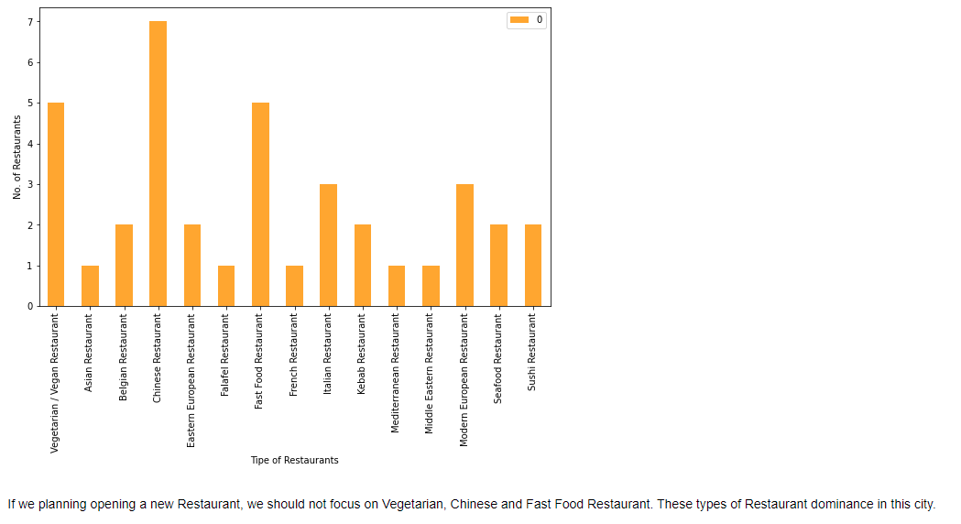
Types of Restaurants

Slide 20
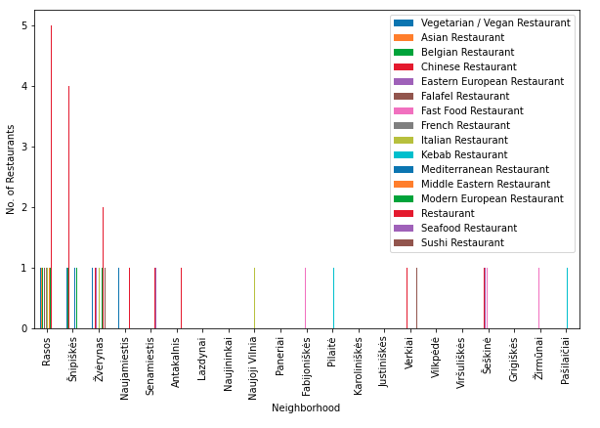
Number of restaurants in the neighborhoods

Slide 21
Results
Based on the Data Analysis and Visualization using Cluster, Folium and Matplotlib we have rendered various bar charts and map from which we can come to a better understanding of the interests we had earlier to be discovered which are specified as follows. From Clustering we can clearly state:
1. The most common venue in Cluster 3 is Pizza Place.
2. In Clusters 1,2 and 4 we can find only a Chinese Restaurant. So there could be a good place to other type of Restaurant.
3. Newcomer should avoid Cluster 0, because there is a lot of different tipes of Restaurants.

Slide 22
Results
Bar charts help us to understand:
1. Specialty restaurants are not very popular in Vilnius.
2. If we planning opening a new Restaurant, we should not focus on Vegetarian, Chinese and Fast Food Restaurant. These types of Restaurant dominance in this city.
3. Neighborhood of Rasos, Šnipiškės and Žvėrynas are leaders comparing with other districts in Restaurant section.

Slide 23
Discussion
We could improve our results and conclusions if we knew whether the stakeholder was looking for a place more in the suburbs (where there is less competition) or whether he would look for a place more in the center (more traffic).
For better results we could use the population of each district. This could help to get an overall picture of how many customers could visit.

Slide 24
Conclusion
In conclusion, to end off this project, we had an opportunity on a business problem, and it was tackled in a way that it was similar to how a genuine data scientist would do. We utilized numerous Python libraries to fetch the information, control the content and break down and visualize those datasets. We have utilized Foursquare API to investigate the settings in neighborhoods of Vilnius. We also visualized utilizing different plots present in seaborn and Matplotlib libraries. We have used Folium to picture different neighborhoods on a map.
In general, it could be one of the tools in developing your business. Whether you want to open a restaurant, a hairdresser, a movie theater, a gym or something else.

